Slide 1
Module 5 : Quality of Service (QoS)
Internet Communication Engineering

Slide 2
Quality of Service
We can informally define quality of service as something a flow of data seeks to attain.
Although QoS can be applied to both textual data and multimedia, it is more an issue when we are dealing with multimedia

Slide 3
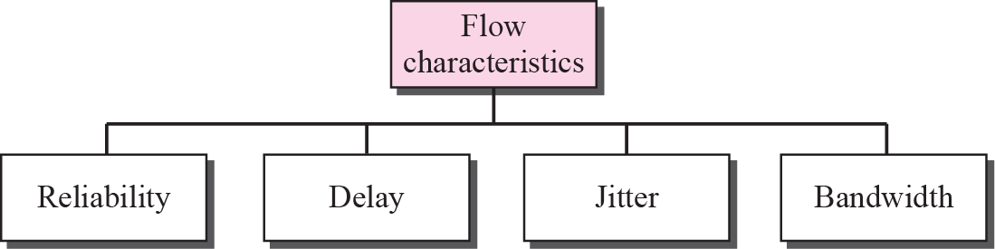
Flow Characteristics
4 types of characteristics are attributed to a flow : Reliability, Delay, Jitter and Bandwidth.

Slide 4
Contd…
Reliability : is a characteristic that a flow needs.
Lack of reliability means losing a packet or acknowledgement which entails retransmission.
Delay : In this case, telephony, audio conferencing, video conferencing and remote log in need minimum delay while delay in file transfer or email is less important.
Jitter : Jitter is defined as the variation in the packet delay. High Jitter means the difference between delays is large, low jitter means the variation is small.

Slide 5
Contd…
Bandwidth : In video conferencing we need to send millions of bits per second to refresh a color screen while the total number of bits in an mail may not reach even a million.

Slide 6
Techniques to improve QoS
Some techniques can be used to improve quality of service.
Common methods are :
Scheduling : Packets from different flows arrive at a switch or router for processing.
Types of scheduling are FIFO Queueing, priority queueing and weighted fair queueing.
Traffic shaping
Admission control
Resource reservation

Slide 7
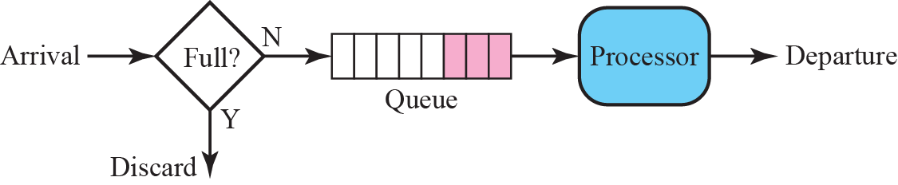
Scheduling : FIFO Queuing
In this method, packets wait in a buffer (Queue) until the node (Router or switch) is ready to process them.
If the average arrival rate is higher than the average processing rate, the queue will fill up and new packets will be discarded.

Slide 8
Scheduling : Priority Queuing
In this method, packets are first assigned to a priority class.
Each priority class has its own queue.
The packets in the highest priority queue are processed first .
Packets in the lowest priority queue are processed last.
The system will not stop serving a queue until it is empty.

Slide 9
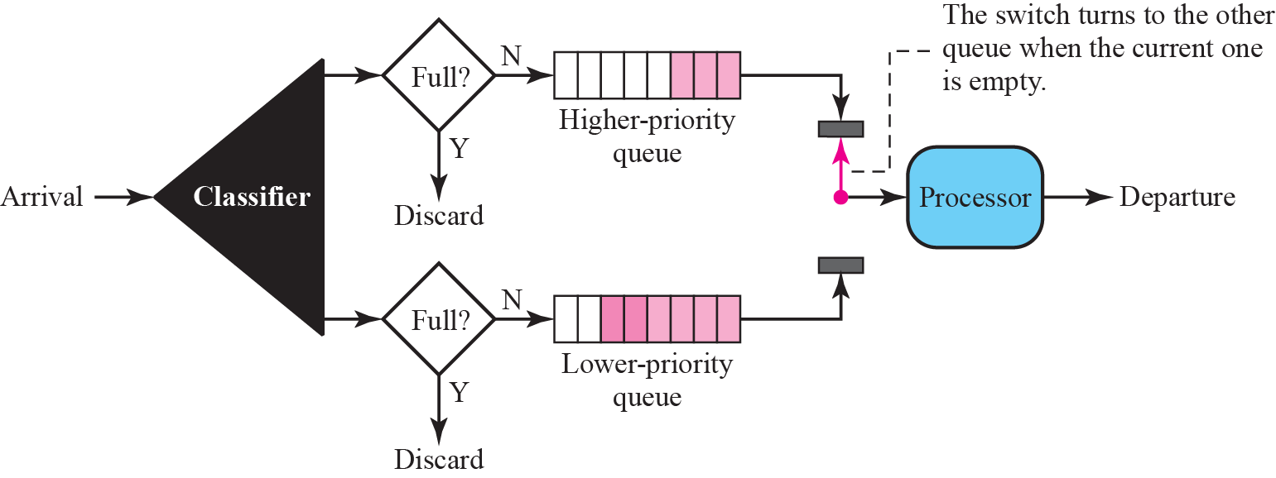
Priority Queues

Slide 10
Contd…
A priority queue can provide better QoS than FIFO queue because higher priority traffic such as multimedia can reach the destination with less delay.
However there is potential drawback- If there is continuous flow in a high priority queue, the packets in the lower priority queues will never have a chance to be processed.
This condition is called as starvation.

Slide 11
Scheduling : Weighted Fair Queuing
In this method also the packets are assigned to different classes and admitted ti different queues.
The queues, however are weighted based on the based on the priority of the queues: Higher priority means higher weight.
System processes packet in each queue in round robin fashion.
For ex. If the weights are 3,2 and 1, then three packets are processed from first queue, two from second queue and 1 from third queue.
If the system does not impose priority on the classes, all weights can be equal.

Slide 12
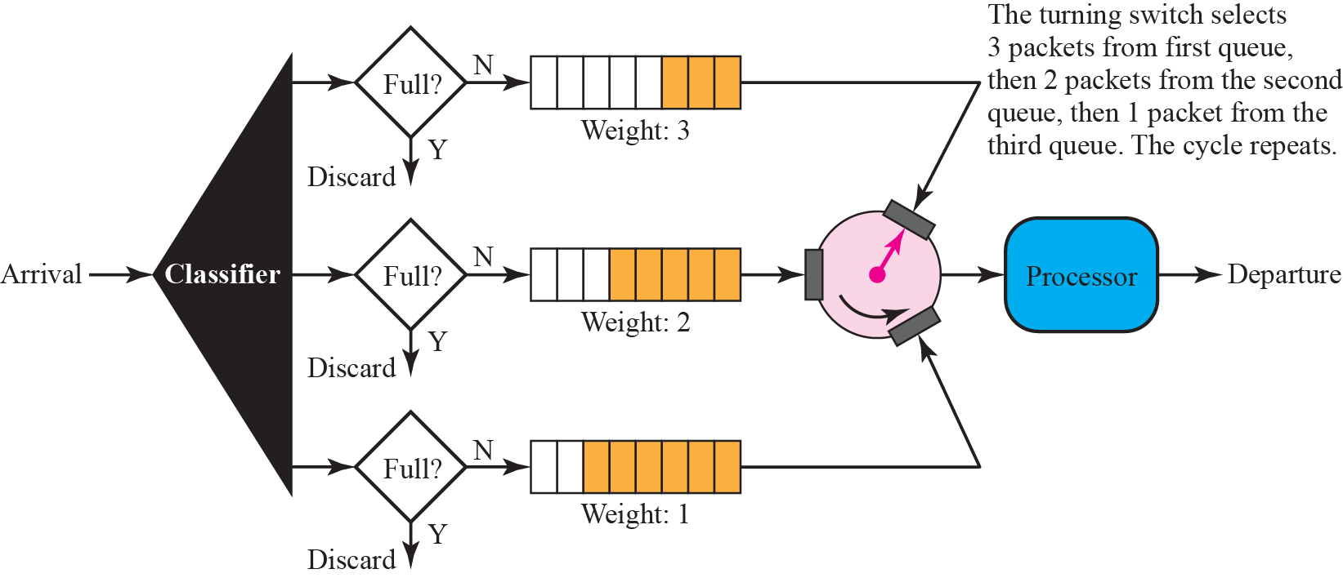
Weighted Fair Queueing

Slide 13
Traffic Shaping
Traffic shaping is a mechanism to control the amount and rate of traffic sent to the network.
Two techniques can shape traffic : leaky bucket and token bucket.

Slide 14
Traffic Shaping: Leaky Bucket
In networking, a technique called leaky bucket can smooth out bursty traffic.
Bursty chunks are stored in the bucket and sent out at an average rate .

Slide 15
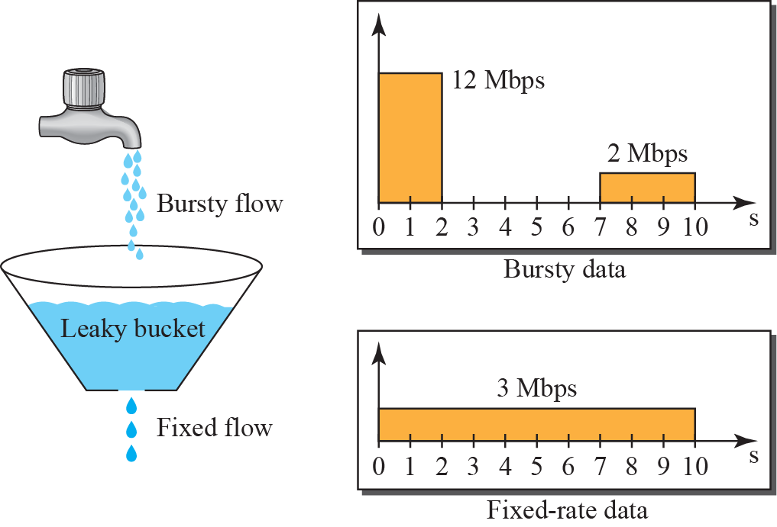
Leaky Bucket

Slide 16
Leaky Bucket Implementation
A FIFO queue holds the packets.
If the traffic consists of fixed size packets, the process removes a fixed number of packets from the queue at each tick of the clock.
If the traffic consists of variable length packets, the fixed output rate must be based on the number of bytes or bits.

Slide 17
Contd…
Following is the algorithm for variable length packets:
Initialize a counter to n at the tick of the clock.
If n is greater than the size of the packet, send the packet and decrement the counter by the packet size. Repeat this until n is smaller than packet size.
Reset the counter and go to step 1.

Slide 18
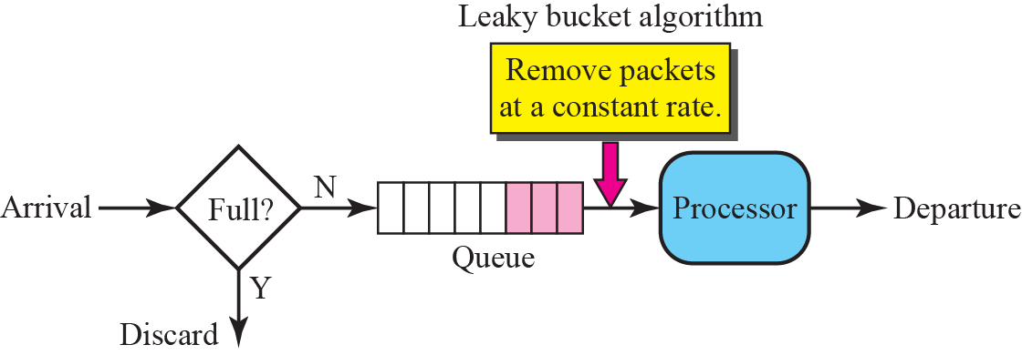
Leaky Bucket Implementation

Slide 19
Traffic Shaping :Token Bucket
The token bucket algorithm allows idle hosts to accumulate credit for the future in the form of tokens.
For each tick of the clock, the system sends n token to the bucket.
The system removes one token for every cell of data sent.
The host can send bursty data as long as the bucket is not empty.

Slide 20
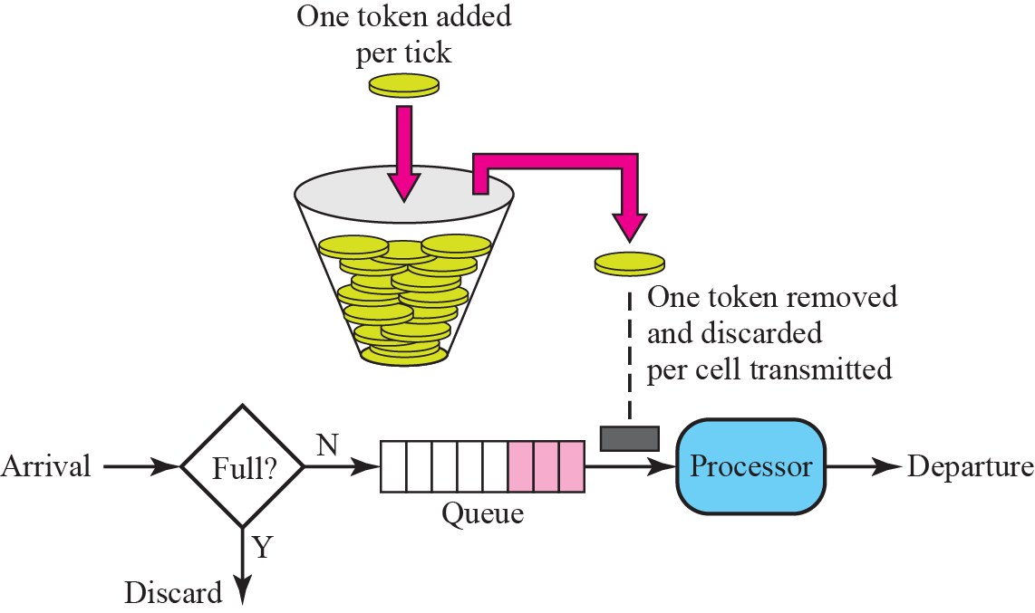
Token Bucket

Slide 21
Traffic Shaping :Token Bucket
The token bucket can easily be implemented with a counter.
The token is initialized to zero.
Each time a token is added, the counter is incremented by 1.
Each time a unit of data is sent, the counter is decremented by 1.
When the counter is zero, the host cannot send data.
Token bucket allows bursty traffic at a regulated maximum rate.

Slide 22
Combining Leaky Bucket and Token Bucket
Two techniques can be combined to credit an idle host and at the same time regulate the traffic.
The leaky bucket is applied after the token bucket.
The rate of leaky bucket needs to be higher than the rate of tokens dropped in the bucket.

Slide 23
Admission Control
Admission control refers to the mechanism used by a router or a switch to accept or reject a flow based on flow specification parameters.
Before a router accepts a flow for processing, it checks the flow specifications to see if its capacity and its previous commitments to other flows can handle the new flow.

Slide 24
Resource Reservation
A flow of data needs resources such as buffer, bandwidth, CPU time etc.
The QoS can be improved by reserving these resources.
The QoS model called integrated services operates on the principle of resource reservation for improvement in QoS.

Slide 25
Models to provide QoS
In order to provide the required QoS in the Internet, the two models have been designed.
The integrated services (Intserv)
The differentiated services (Diffserv)
Both models have been designed for quality of service at the network layer (IP) but they can also be used in other layers such as the data link.

Slide 26
Best Effort Delivery
IP was originally designed for best effort delivery.
In the best effort delivery, every user receives the same level of services.
It does not guarantee the minimum of a service such as sufficient bandwidth to the applications such as real time audio & video.
If the multimedia application gets extra bandwidth accidentally then it may result in congestion.

Slide 27
Integrated Services (Intserv)
Integrated services is a flow based QoS model designed for IP.
In this, a user needs to create a flow, a kind of virtual circuit, from the source to the destination and inform all routers of the resource requirement.

Slide 28
Signaling
IP is a connectionless datagram packet switching protocol.
To implement a flow based model over a connectionless protocol, a signaling protocol is used to provide signaling mechanism for making a reservation.
This protocol is called Resource Reservation Protocol (RSVP).

Slide 29
Flow Specification
When a source makes a reservation, it needs to define a flow specification.
A flow specification has two parts : Rspec (Resource Specification) and Tspec (Traffic Specification).
Rspec defines the resource that the flow needs to reserve.
Tspec defines the traffic characterization of the flow.

Slide 30
Admission
After a router receives the flow specification from an application, it decides to admit or deny the service.
The decision is based on the previous commitments of the router and the current availability of the resource.

Slide 31
Service Classes
Two classes of services have been defined for Integrated services : Guaranteed service and controlled load service.
Guaranteed Service Class : This service is designed for real time traffic that needs a guaranteed minimum end to end delay.
The end to end delay is the sum of the delays in the routers, the propagation delay in the media and the setup mechanism.
Guaranteed services are quantitative services in which the amount of end to end delay and the data rate must be defined by the application.

Slide 32
Contd….
Controlled Load Service Class : This service is designed for applications that can accept some delays but are sensitive to an overloaded network and to the danger of losing packets.
Good examples of these types of applications are file transfer, email and Internet access.
It is a qualitative type of service in that the application requests the possibility of low loss or no loss packets.

Slide 33
RSVP
The Resource Reservation Protocol (RSVP) is a signalling protocol to help IP create a flow and consequently make a resource reservation.
It is an independent protocol separate from Integrated Services model.
RSVP is a signalling system designed for multicasting.
The reason for this design is to enable RSVP to provide resource reservations for all kinds of traffic including multimedia which often uses multicasting.

Slide 34
Contd…
In RSVP, the receivers not the sender make the reservation.
For ex, in multicast routing protocols, the receivers not the sender make a decision to join or leave a multicast group.

Slide 35
RSVP Messages
RSVP has several types of messages. However, in our case only Path and Resv these two are important.
Path Messages : A path message travels from the sender and reaches all receivers in the multicast path.
On the way, a path message stores the necessary information for the receivers.
A path message is sent in multicast environment.
A new message is created when the path diverges.

Slide 36
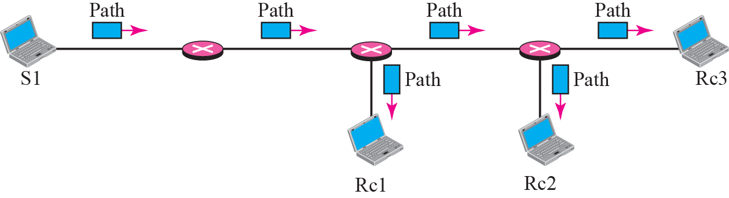
Path Messages

Slide 37
Resv Messages
After a receiver has received a path message, it sends a Resv message.
The Resv message travels toward the sender (upstream) and makes a resource reservation on the routers that support RSVP.
If a router does not support RSVP on the path, it routes the packet based on the best effort delivery methods.

Slide 38
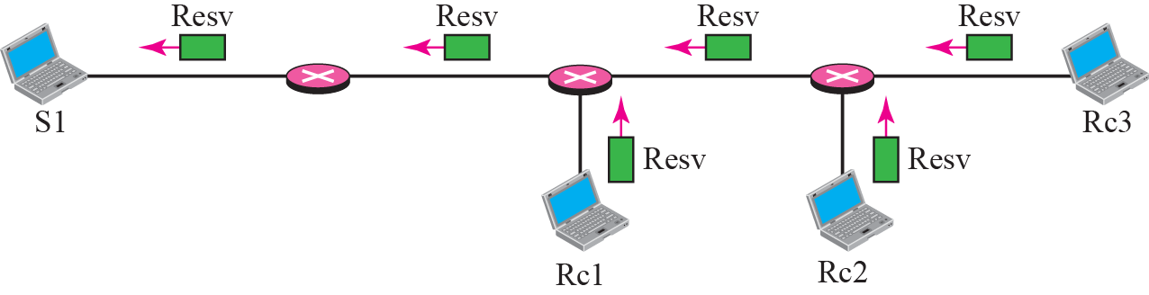
RESV Messages

Slide 39
Reservation Merging
In RSVP, the resources are not reserved for each receiver in a flow, the reservation is merged.
For ex, in a fig. if Rc3 requests a 2 Mbps bandwidth while Rc2 requests a 1 Mbps bandwidth.
Router R3 which needs to make a bandwidth reservation, merges the two requests.

Slide 40
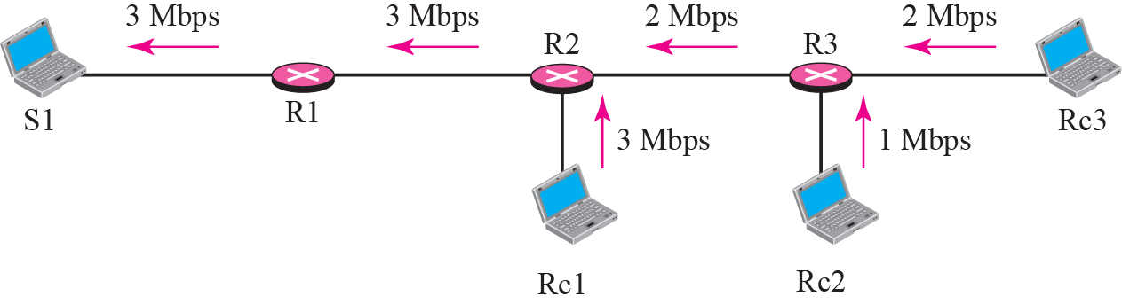
Reservation Merging

Slide 41
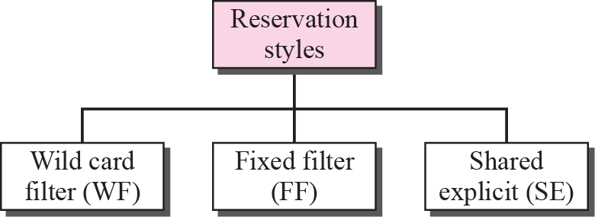
Reservation Styles
When there is more than one flow, the router needs to make a reservation to accommodate all of them.
RSVP defines 3 types of reservation styles.

Slide 42
Reservation Styles
Wild card filter style : In this style, the router creates a single reservation for all senders.
The reservation is based on the largest requests.
This type of style is used when the flows from different senders do not occur at the same time.

Slide 43
Reservation Styles
2. Fixed filter style : In this style, the router creates a distinct reservation for each flow.
This means that if there are n flows, n different reservations are made.
This type of style is used when there is a high probability that flows from different senders will occur at the same time.

Slide 44
Reservation Styles
3. Shared explicit style : In this style, the router creates a single reservation that can be shared by a set of flows.
Soft State : The reservation information (State) stored in every node for a flow needs to be refreshed periodically.
This is referred as soft state as compared to hard state used in other virtual circuit protocols such as ATM or frame relay, where the information about the flow is maintained until it is erased.
The default interval for refreshing is currently 30s.

Slide 45
Problems with Integrated Services
Scalability : The Integrated Services model requires that each router keep information for each flow.
As Internet is growing every day, this is a serious problem.
2. Service Type limitation : The Integrated Services model provides only two types of services, guaranteed and control load.
- Those opposing this model argue that applications may need more than these two types of services.

Slide 46
Differentiated Services
Differentiated services (DS or Diffserv) was introduced to handle the shortcomings of Integrated Services. Two fundamental changes were made:
The main processing was moved from the core of the network to the edge of the network. This solves the scalability problem.
The routers do not have to store information about flows.
The applications, or hosts define the type of service they need each time they send a packet.
2. The per flow service is changed to per class service .
The router routes the packet based on the class of service defined in the packet, not the flow.
This solves the service type limitation problem.
Diffserv is a class based QoS model designed for IP.

Slide 47

DS Field
In Diffserv, each packet contains a field called the DS field.
The value of this field is set at the boundary of the network by the host or the first router designed as the boundary router.
IETF proposes to replace the existing TOS (Type of Service) field in IPv4 or the class field in IPv6 by DS field.

Slide 48
DS Field
There are 2 subfields : DSCP and CU.
DSCP (Differentiated Services Code Point) is a 6-bit subfield that defines per hop behaviour (PHB).
2 bit CU (Currently Unused) subfield is not currently used.
The Diffserv capable node (Router) uses the DSCP 6 bits as an index to a table defining the packet handling mechanism for the current packet being processed.

Slide 49
Per Hop Behavior (PHB)
Diffserv model defines per hop behaviours (PHBs) for each node that receives a packet.
3 PHBs are defined : DE PHB, EF PHB and AF PHB.
DE PHB (Default PHB) : Same as best effort delivery which is compatible with TOS.
EF PHB (Expedited forwarding PHB): Same as having a virtual connection between the source and destination . It provides the services like Low loss, Low latency and Ensured bandwidth.
AF PHB(Assured forwarding PHB) : delivers the packet with a high assurance as long as the class traffic does not exceed the traffic profile of the node.

Slide 50
Traffic Conditioner
To implement Diffserv, DS node uses traffic conditioners such as meters, markers, shapers and droppers.
1. Meters : The meter checks to see if the incoming flow matches the negotiated traffic profile.
It also sends this result to other components.
It can use several tools such as token bucket to check the profile.
2. Marker : A marker can remark a packet that is using best effort delivery or down-mark a packet based on information received from the meter.

Slide 51
Traffic Conditioner
3. Shaper : A shaper uses the information received from the meter to reshape the traffic if it is not compliant with the negotiated profile.
4. Dropper : A dropper which works as a shaper with no buffer, discards packets if the flow severely violates the negotiated profile.

Slide 52
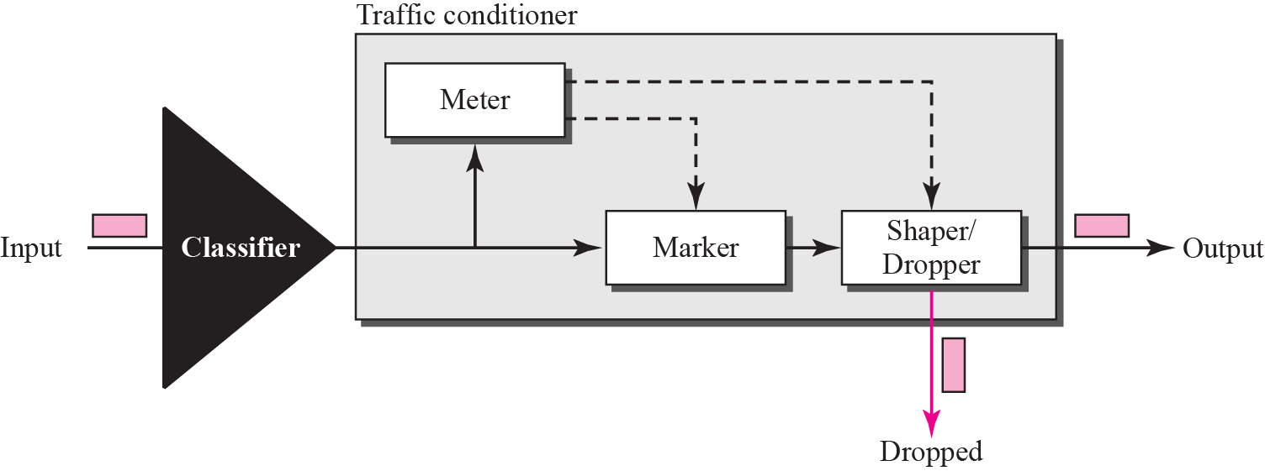
Traffic Conditioner

Slide 53
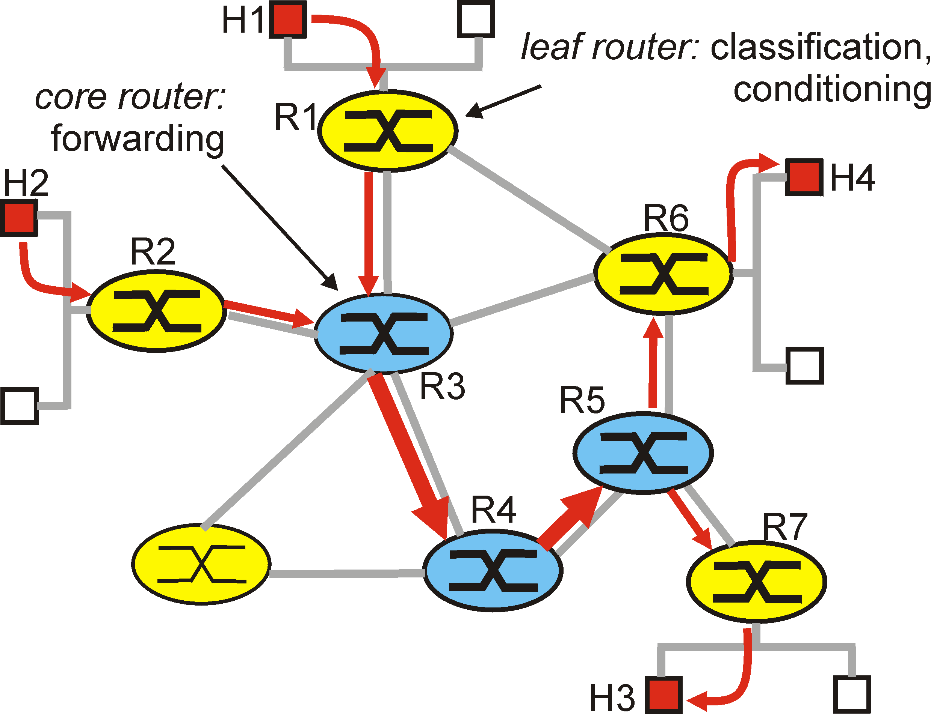
Architectural Components of DS Model

Slide 54
Contd…
The differentiated services architecture consists of two sets of functional elements:
1. Edge functions: packet classification and traffic conditioning
At the incoming "edge" of the network (i.e., at either a differentiated services capable host that generates traffic or at the first DS-capable router that the traffic passes through), arriving packets are marked.
Differentiated Service (DS) field of the packet header is set to some value.
For ex, in Figure ,packets being sent from H1 to H3 might be marked at R1, while packets being sent from H2 to H4 might be marked at R2.
The mark that a packet receives identifies the class of traffic to which it belongs. Different classes of traffic will then receive different service within the core network.

Slide 55
Contd…
2.Core function: forwarding
When a DS-marked packet arrives at a DS-capable router, the packet is forwarded onto its next hop according to per-hop behavior associated with that packet's class.
The per-hop behavior influences how a router's buffers and link bandwidth are shared among the competing classes of traffic.
Router's per-hop behavior will be based only on packet markings, i.e., the class of traffic to which a packet belongs.
Thus, if packets being sent from H1 to H3 receive the same marking as packets from H2 to H4, then the network routers treat these packets as a aggregate, without distinguishing whether the packets originated at H1 or H2.
For example, R3 would not distinguish between packets from H1 and H2 when forwarding these packets on to R4.

Slide 56
